Slide 1
The following presentation is supplemental to NCHRP Research Report 1100: MASH TL-3 Deflection Reduction for 31-Inch Guardrail: A Guide (NCHRP Project 22-38).
The National Cooperative Highway Research Program (NCHRP) is sponsored by the individual state departments of transportation of the American Association of State Highway and Transportation Officials. NCHRP is administered by the Transportation Research Board (TRB), part of the National Academies of Sciences, Engineering, and Medicine, under a cooperative agreement with the Federal Highway Administration (FHWA). Any opinions and conclusions expressed or implied in resulting research products are those of the individuals and organizations who performed the research and are not necessarily those of TRB; the National Academies of Sciences, Engineering, and Medicine; the FHWA; or NCHRP sponsors.

Slide 2
Development of MASH TL-3 Deflection Reduction Guidance for 31- Inch Guardrail
NCHRP Project 22-38
James Kovar, B.S.C.E
Texas A&M Transportation Institute,
College Station, Texas

Slide 3
Problem Discussion & Objectives
Stiffening of guardrail systems is needed when minimal setback distance from hazard exists
AASHTO Roadside Design Guide provides guidelines on this topic based upon NCHRP Report 350 testing and evaluation
Objectives:
Develop guidelines for using stiffening mechanisms with the goal of reducing deflections on MGS
Develop guidelines for safely transitioning the stiffness
Guidelines could be considered for inclusion in AASHTO RDG

Slide 4
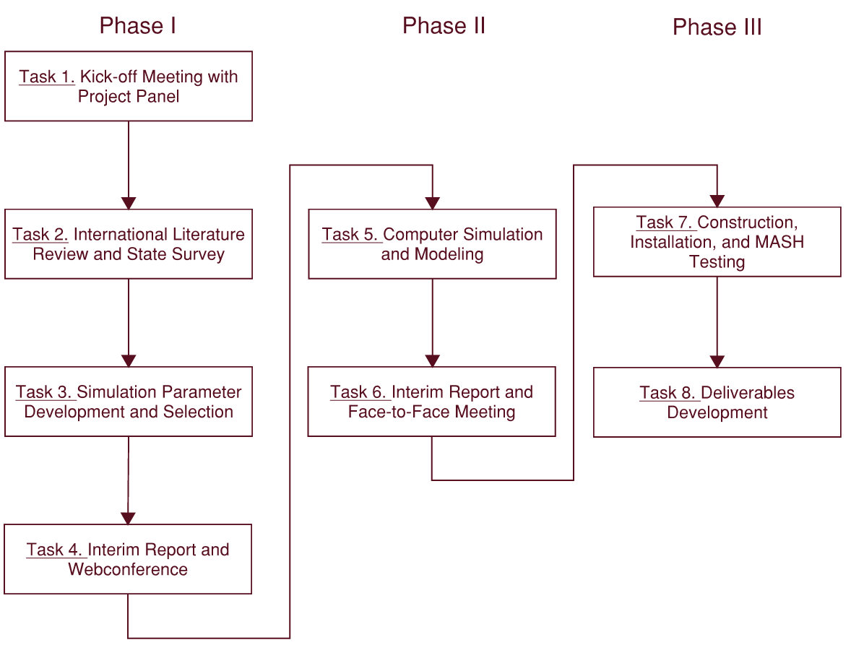
Work Plan

Slide 5
Task 2: International Literature and State Survey
Review relevant literature and research to identify stiffening mechanisms
Develop web survey aimed at identifying current stiffening practices

Slide 6
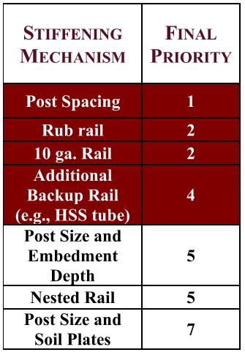
Task 3: Simulation Parameter Development and Selection
Review results of literature review and state survey
Identify which mechanisms could successfully stiffen the Midwest Guardrail System (MGS)
Promote those mechanisms to computer simulation in Task 5
Eliminate the other mechanisms from further investigation
Final selections for computer simulation evaluation highlighted in maroon
.

Slide 7
Task 5: Computer Simulation and Modeling
Evaluate the deflection reducing ability of the selected mechanisms from Task 3
Develop method to safely transition the change in stiffness

Slide 8
Summary of Successful Computer Simulations
Stiffening Mechanism | Stiffening Element | Location | 3-11 | 3-11 Dynamic Deflection (inches) | 3-10 | 3-21 | 3-20
Baseline | None | N/A | Pass | 43.9 | -- | -- | --
Rub Rail | C6x8.2 | 12 inches Above Grade | Pass | 34.7 | DNS | DNS | DNS
Rub Rail | C6x8.2 | 6 inches Above Grade | Pass | 36.0 | DNS | DNS | DNS
Rub Rail | 10HU5x075 | 12 inches Above Grade | Pass | 31.5 | DNS | DNS | DNS
10 ga | 10 ga. Rail | N/A | Pass | 39.2 | Pass | Pass | DNS
Backup Rail | C6x8.2 | Centerline of W-beam | Pass | 36.4 | DNS | DNS | DNS
Backup Rail | C6x8.2 | 12 inches Above Grade | Pass | 38.8 | DNS | DNS | DNS
Backup Rail | HSS4x4x1/4 | 17.5 inches Above Grade | Pass | 31.1 | DNS | DNS | DNS
Backup Rail | HSS4x4x1/4 | Centerline of W-beam | Pass | 33.7 | Pass | DNS | DNS
Backup Rail | 8HU12x135 | Centerline of W-beam | Pass | 25.4 | Pass | DNS | DNS
Backup Rail | HSS8x8x1/4 | Blockout Replacement | Pass | 15.4 | Pass | Pass | Pass
Reduced Post Spacing | 1/2 PS | N/A | *Pass | *25.6 | NC | Pass | NC
Reduced Post Spacing | 1/4 PS | N/A | *Pass | *19.5 | *Pass | *Pass | NC
Combination | 1/2 PS & HSS8x8x3/16 Blockout Replacement | Blockout Replacement | Pass | 11.1 | DNS | DNS | DNS
Combination | 1/4 PS and HSS4x4x1/4 | Centerline of W-beam | Pass | 10.1 | Pass | Pass | Pass
Combination | 1/2 PS & HSS8x8x1/4 Blockout Replacement | Blockout Replacement | Pass | 10.0 | DNS | DNS | DNS
Combination | 1/4 PS & HSS8x8x1/4 Blockout Replacement | Blockout Replacement | Pass | 7.4 | Pass | Pass | Pass
* Denotes results from physical crash test rather than simulation DNS = Did Not Simulate NC = Justified as Not Critical

Slide 9
Task 7: Construction, Installation, and MASH Testing
The following systems were evaluated through full-scale MASH crash testing
Half-post spacing with HSS8x8x3/16 blockout replacement tube (MASH Tests 3-11 & 3-10)
Transition from MGS to half-post spacing with HSS8x8x3/16 blockout replacement tube (MASH Tests 3-21 & 3-20)
MASH Test Level | Testing Vehicle Type | Vehicle Weight (lbs) | Nominal Speed (mph) | Nominal Angle (degrees) | Test Designation
TL-3 | Passenger Car | 2,420 | 62 | 25 | 3-10, 3-20
TL-3 | Pickup Truck | 5,000 | 62 | 25 | 3-11, 3-21

Slide 10
Project Conclusions
The stiffened MGS with the half-post spacing and HSS8x8x3/16 blockout replacement tube successfully met MASH evaluation criteria for tests 3-11 and 3-10
The transition from full-post spacing MGS to this stiffened system also successfully met MASH evaluation criteria for tests 3-21 and 3-20
Both the length-of-need and transition are suitable for implementation on the roadside
Specific implementation guidelines are provided in the final report, NCHRP Research Report 1100: MASH TL-3 Deflection Red
An updated guardrail deflection table was provided for possible inclusion in the RDG

Slide 11
Questions /Comments
James Kovar
Assistant Research Scientist
Texas A&M Transportation Institute
Ph.: 979-317-2680
E-mail: j-kovar@tti.tamu.edu

